Slide 1





...........
PRESENTATION - 2025
Store sales
DATASET ANALYSIS
..............

Slide 2









Data Pipeline
Data Collection
Data Cleaning
Data Validation
Exploratory Data Analysis
(EDA)
Monitoring
Data visualization
Forecasting model
Data Analysis

Slide 3



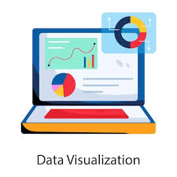
overview
Week 1:
Week 2:
Week 3:
Week 4:
Build Data Model, Data Cleaning and Preprocessing
Data Preprocessing: Build a data model and clean and preprocess the data.
Deliverables:
- Cleaned dataset ready for analysis.
- Data preprocessing notebook.
Analysis Questions Phase
Determine Data Analysis Questions: Determine all possible analysis questions that can be deducted from the given dataset and would be of interest to the organization’s decision makers.
Forecasting Questions Phase
Determine a set of forecasting questions and answer them using the trends found in the given dataset.
Visualization Dashboard and Final Presentation
Build a Visualization Dashboard: Build a Tableau visualization dashboard that visualizes the answers to all answered questions.

Slide 4
Week 1

Slide 5
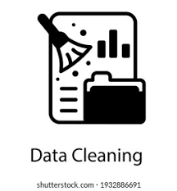
1. Data Cleaning
Focus: Focus on ensuring high data quality through rigorous cleaning, handling missing values, and correcting inconsistencies before modeling.
Key Message: Ensure data integrity and model accuracy by laying a strong foundation through effective cleaning, preprocessing, and thoughtful model building.

Slide 6

2. Tools Used
In this project, we used Python as one of the most important languages ​​in the data cleaning and model building process.
We have used some important libraries in the data cleaning process such as numpy and pandas libraries and other libraries for the visualization process such as matplotlib and seaborn libraries.

Slide 7

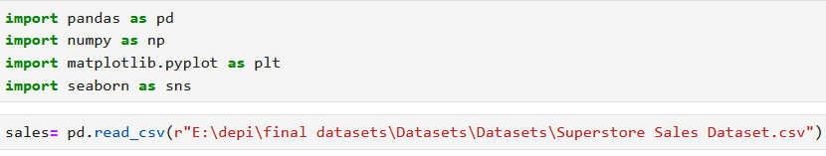
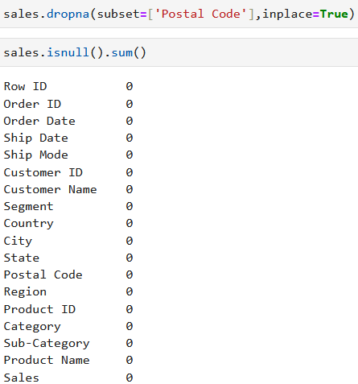

3. Sample of code
https://github.com/Tarek2882004/DEPI_project/tree/main/Week%201/Data%20preprocessing%20notebook

Slide 8
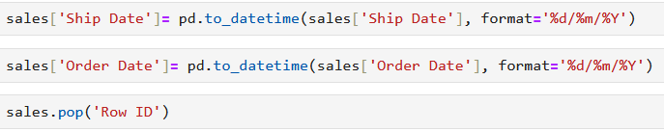
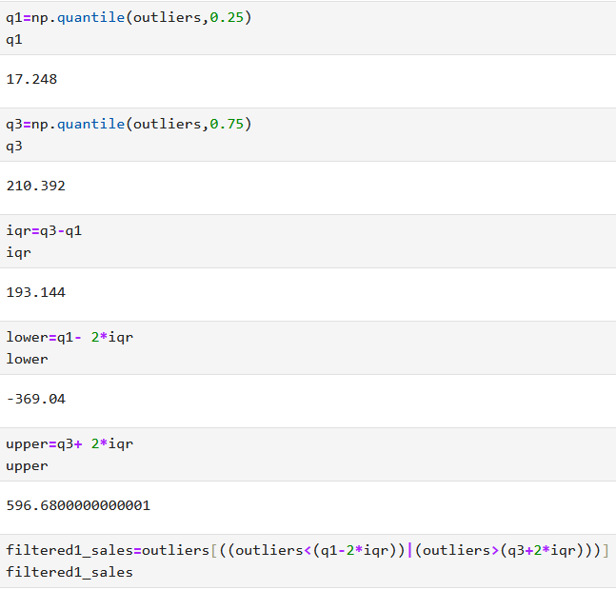
3. Sample of code

Slide 9
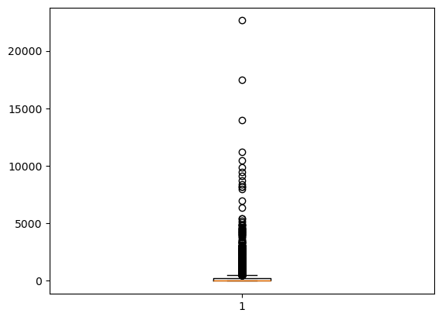
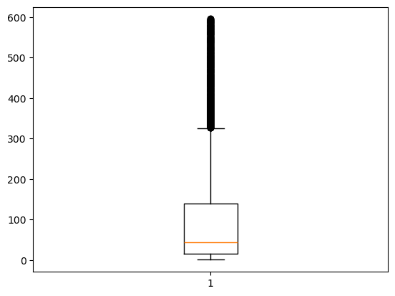
4. Comparison
We found in our data that there are some abnormal values, or what are called outliers, that are either higher than normal or lower, so we use the IQR and then remove these outliers, as shown in the figure.

Slide 10
Week 2

Slide 11

1. Analysis Questions
Focus: Focus on formulating meaningful, data-driven questions that align with business objectives and guide the entire analysis process toward actionable insights.
Key Message: Well-defined questions are the foundation of impactful analysis — they ensure clarity, direction, and relevance to real-world objectives.

Slide 12
2. Tools Used
In this project, we used Python as one of the most important languages ​​in the data cleaning and model building process.
We have used some important libraries in the data cleaning process such as numpy and pandas libraries and other libraries for the visualization process such as matplotlib and seaborn libraries.

Slide 13
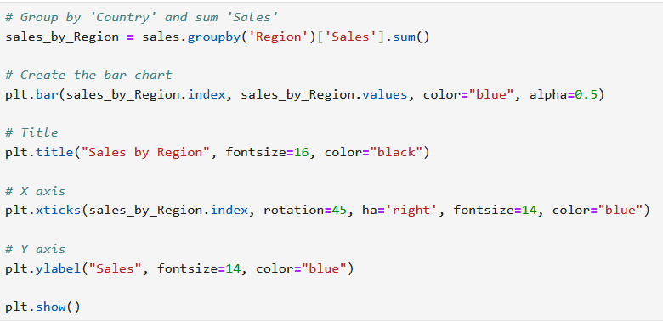
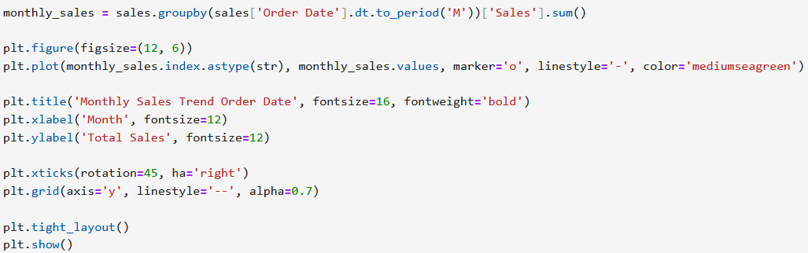
3. Sample of code

Slide 14
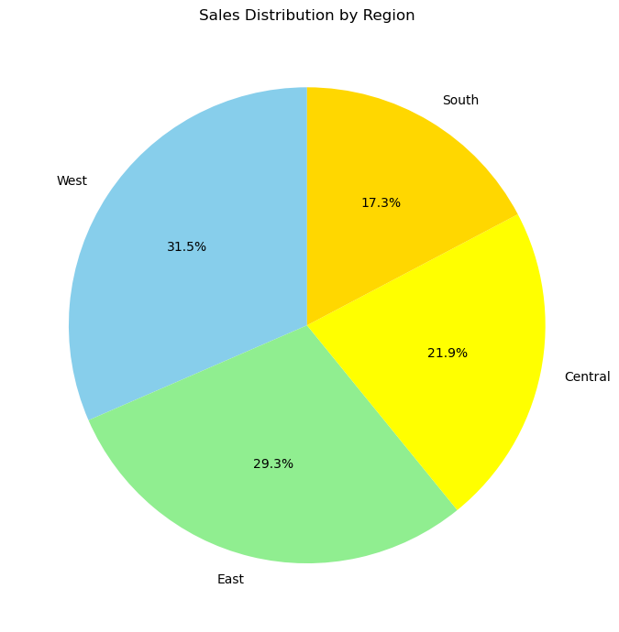
3. Sample of Question
1. What are the total sales by region?
From the chart shown, we found that the Western and Eastern regions are the regions with the highest sales.
We also found that the southern region is the least.

Slide 15
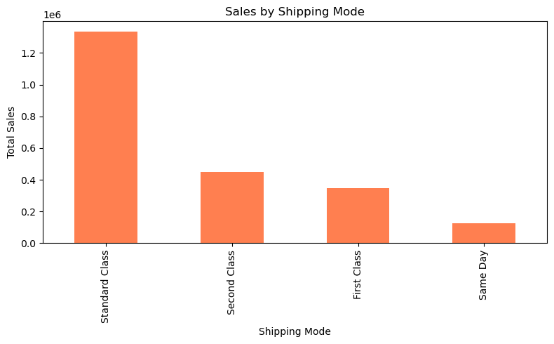
3. Sample of Question
1. What are the total sales by Shipping Mode?
The bar chart shows total sales by shipping mode. Standard Class has the highest sales, exceeding 1.3 million. It is followed by Second Class and First Class, while Same Day shipping has the lowest sales. This indicates that most customers prefer the Standard Class shipping method over other options.

Slide 16
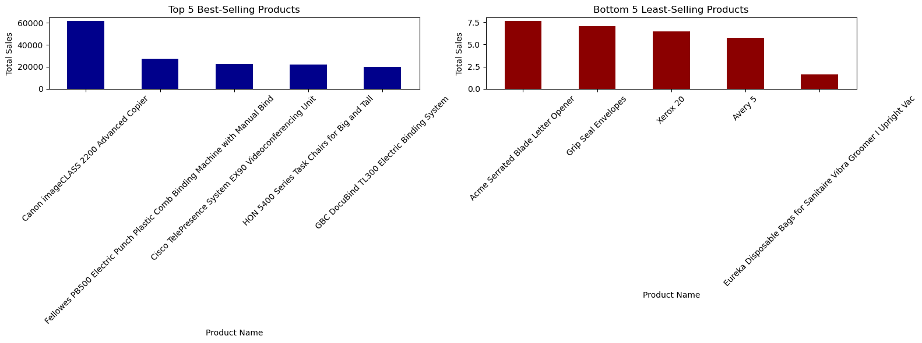
3. Sample of Question
What are the top and bottom performing sub-categories?
The chart shows the 5 best-selling and 5 least-selling products.
The Canon imageCLASS 2200 Advanced Copier is the top-selling product.
Other popular products include machines and office equipment.
The Eureka Disposable Bags sold the least.
Other low-selling items include letter openers and envelopes.

Slide 17
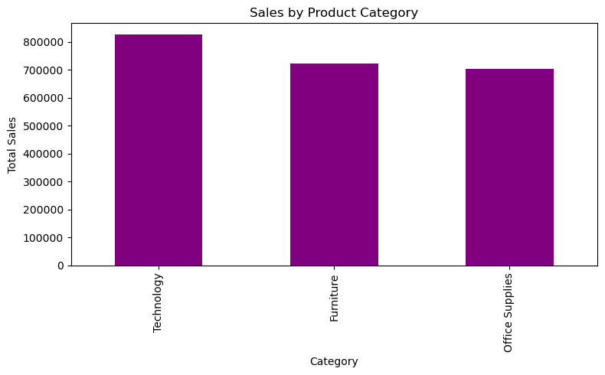
3. Sample of Question
2. What is the total sales by category?
From the chart shown, we find that the Technology category occupies a very large portion of sales.
Sales of the remaining categories (furniture and office supplies) may be closer to equality in total sales.

Slide 18
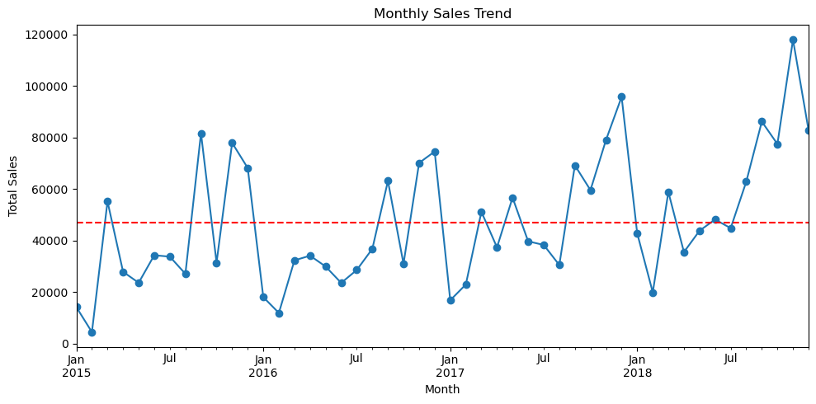
3. Sample of Question
3. How have total sales changed over time on a monthly basis?
Key Insights:
There is a general upward trend in sales over time, especially noticeable in the second half of 2018.
Sales fluctuate significantly month to month, indicating possible seasonality or promotional spikes.
Sharp peaks appear during certain months (e.g., late 2018), which may correspond to high-demand periods such as holidays or major sales campaigns.

Slide 19
4. Click to see all the questions extracted from the data.
https://github.com/Tarek2882004/DEPI_project/tree/main/Week%202/Data%20Analysis%20Questions

Slide 20
Week 3

Slide 21

1. Sales Forecasting with ARIMA Model
Objective: To forecast total sales using historical data, performing data ingestion from SQL Server, exploratory data analysis, ARIMA modeling.
Technologies Used: Python, Pandas, Matplotlib, ARIMA (from statsmodels).

Slide 22
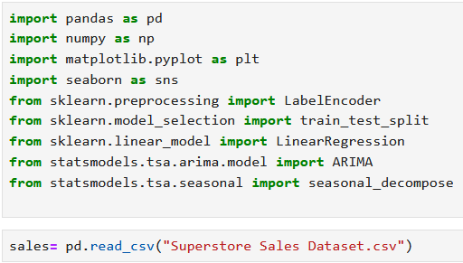
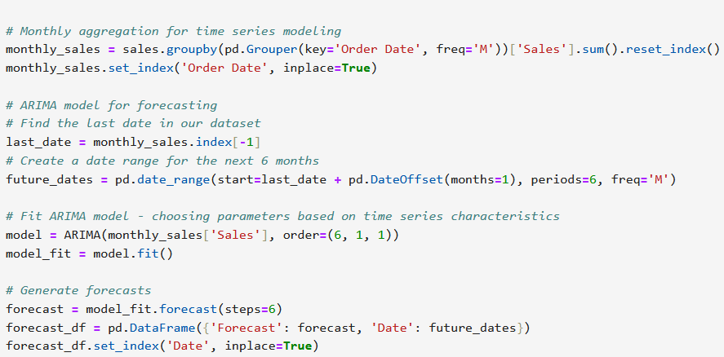
2. Sample of code
https://github.com/Tarek2882004/DEPI_project/tree/main/Week3/set%20of%20forecasting%20questions

Slide 23
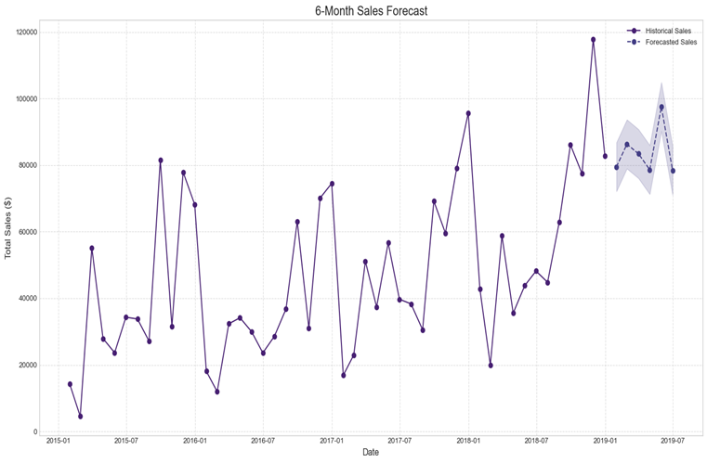
3. Forecasting
Forecasting: The model was used to forecast sales for the next 6 months, providing a projection of future sales based on historical data.

Slide 24
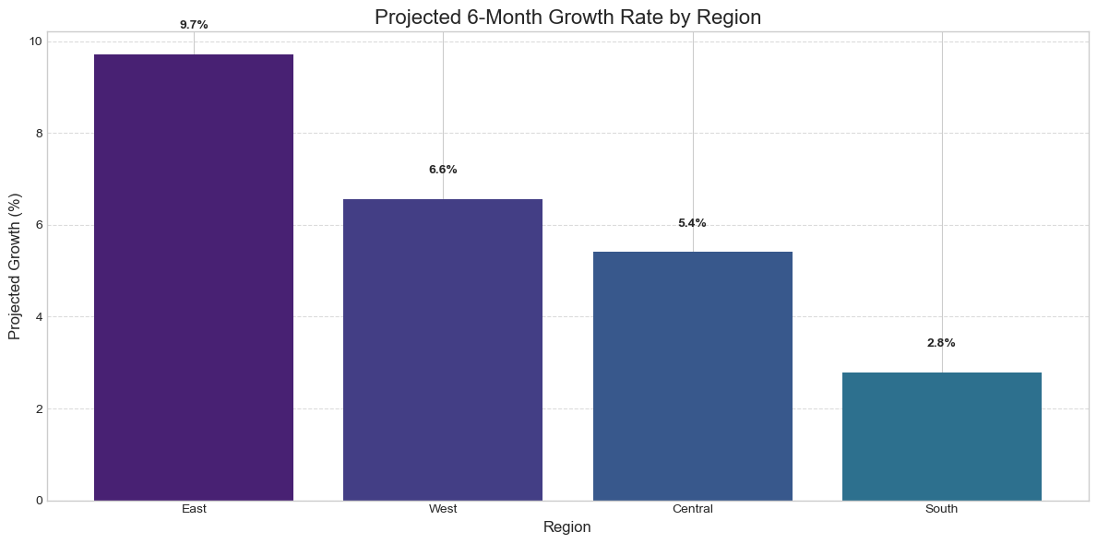
3. Forecasting
The model was used to forecast the increase in sales percentage for each region, providing insights into potential growth based on historical data.
https://github.com/Tarek2882004/DEPI_project/tree/main/Week3/set%20of%20forecasting%20questions

Slide 25
Week 4

Slide 26

1. Visualization Dashboard
Focus: Focus on transforming raw data into clear, interactive dashboards that enable quick and informed data-driven decisions.
Key Message: Effective data visualization turns complexity into clarity, empowering teams to uncover insights and act with confidence.

Slide 27

2. Tools Used
In this project, we used one of the most important data visualization programs, Tableau, which is distinguished by its storytelling feature, the importance of which lies in how to convey the purpose of the analysis to non-technical people.

Slide 28
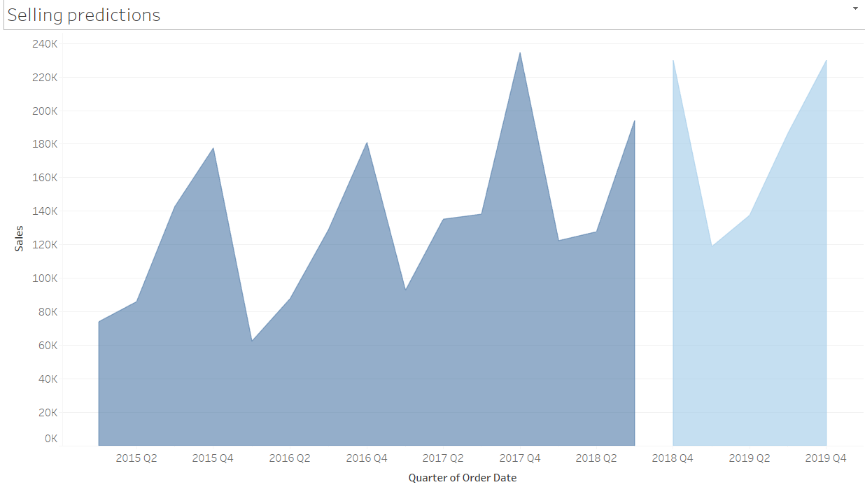
3. Predicting sales future based on the past

Slide 29
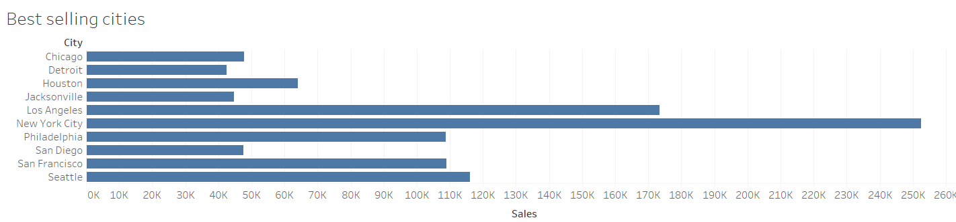
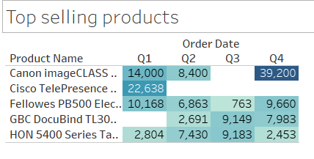
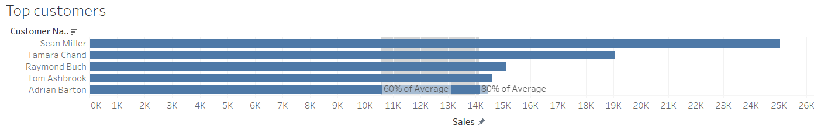
4. Best of the Best

Slide 30
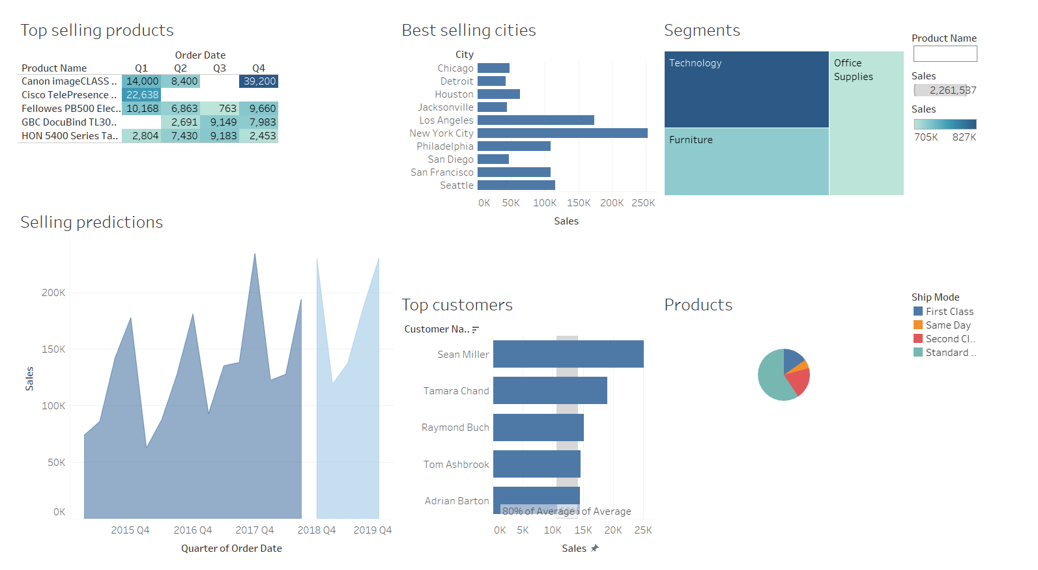
5. Our Dashboard

Slide 31

Click to view the week 4
Click to view the week 4

Slide 32
Click to view all works during the four weeks
https://github.com/Tarek2882004/DEPI_project

Slide 33
TEAM MEMBERS
Samah Elsayed Hamed
Maryam Qasim Abdul Hafeez
Mahmoud Samir Abdelrahim
Hassan Alaaeldin Hassan
Tarek Mostafa Mohamed Kashef

Slide 34

................
PRESENTATION - 2025
THANK YOU
................

